Slide 1
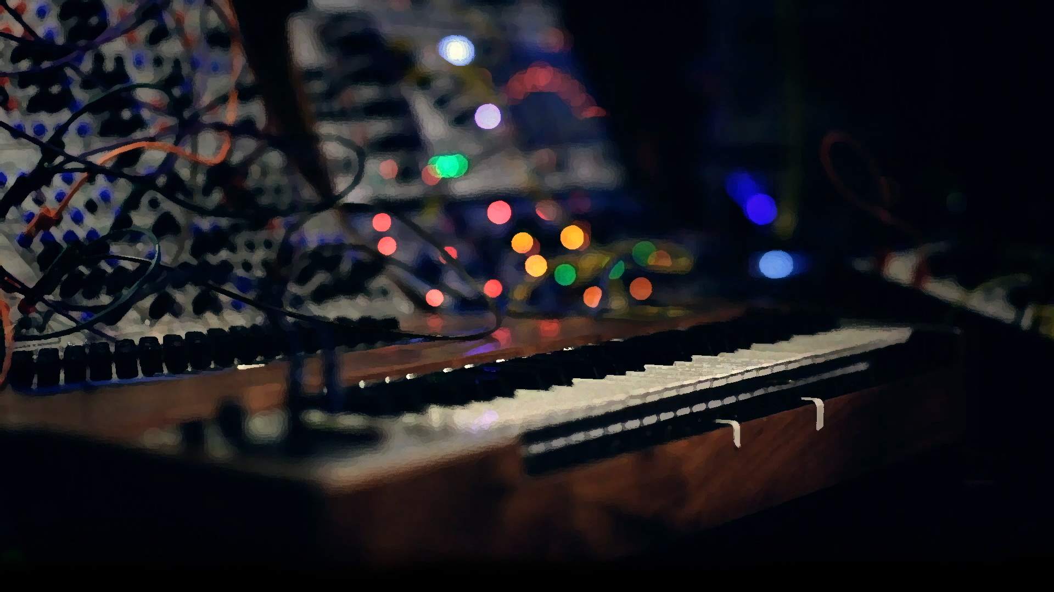
Designing Software for a Wavetable Audio Synthesiser
Marco Rademan (21561273)
Supervised by Professor Jaco Versfeld

Slide 2
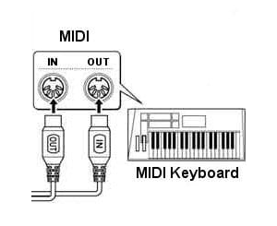
Introduction
Design and implement a wavetable-based synthesiser engine
Targeted for microcontrollers
High quality stereo audio
Implements the fundamental synthesis features:
Volume modulation
Filtering and cut-off modulation
ADSR envelope control
FM
Waveshaping
Plays up to a fixed number of notes
Ideal for MIDI integration
MIDI
Musical Instrument Digital Interface
Communication protocol for note/parameter information based on UART.

Slide 3
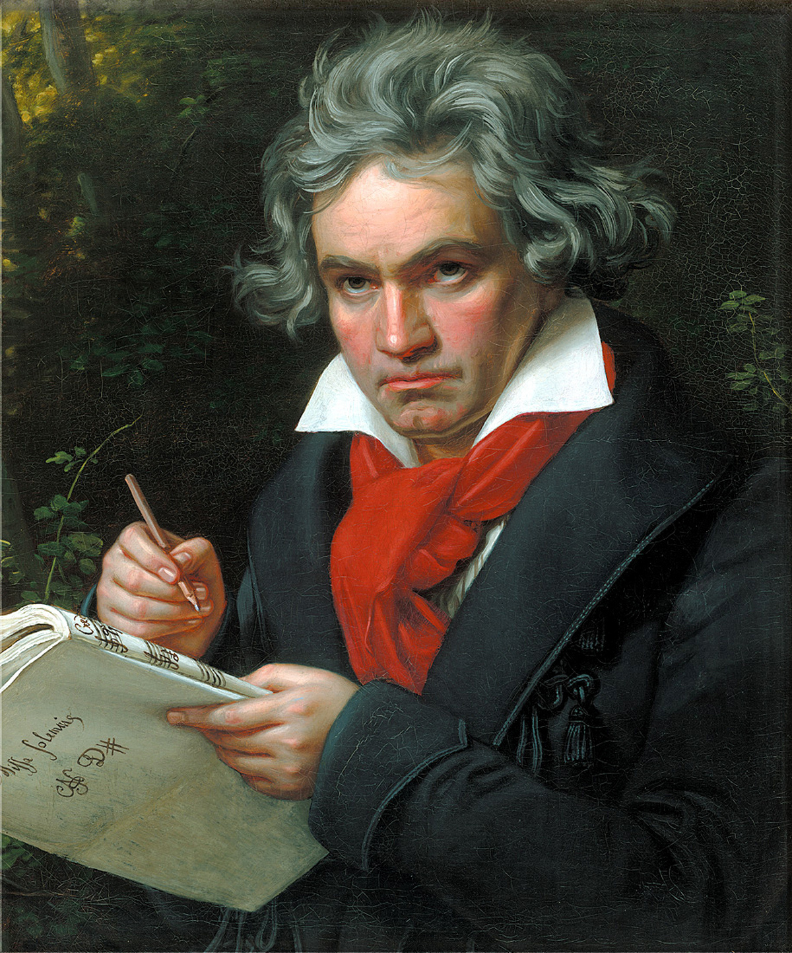
Presentation Overview
Audio demo (Moonlight Sonata)
Modular synthesis as building blocks
Software components and tests
LUTs and wavetables
ADSR envelope
IIR filtering
Waveshaping
Generator
Generator manager
Full system test
Conclusion
Ludwig van Beethoven
Moonlight Sonata (from MIDI file)
Audio demo for 5 synth configurations.
Audio available on Github and YouTube.
Refer to report for links.

Slide 4
System Description

Slide 5
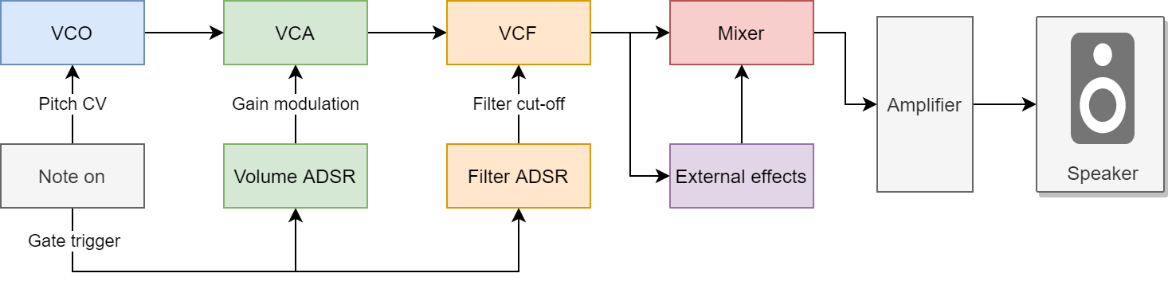
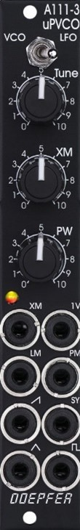
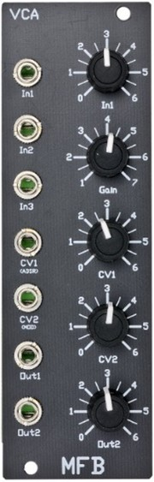
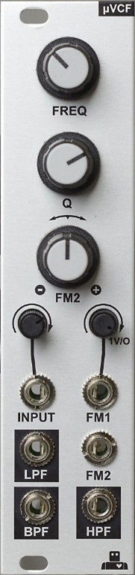
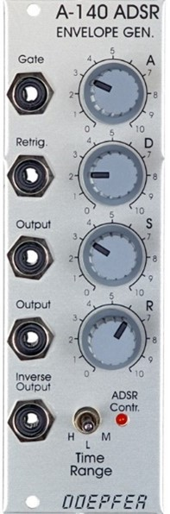
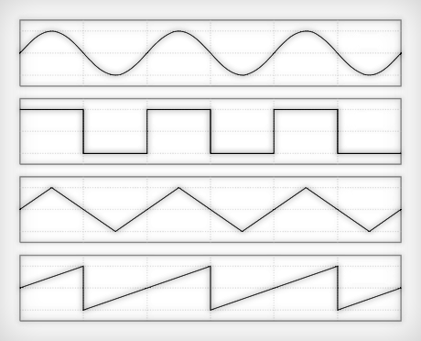
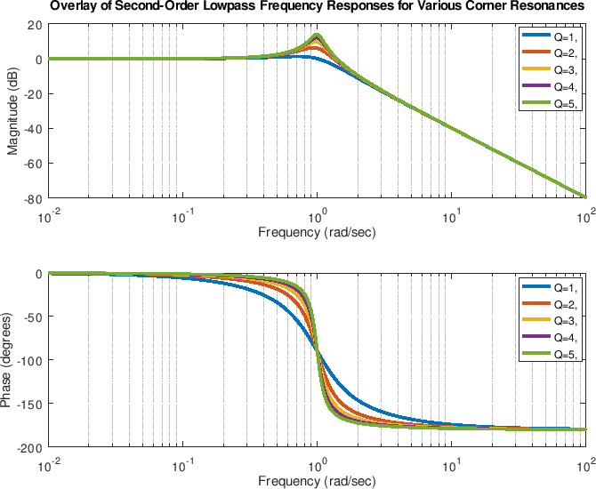
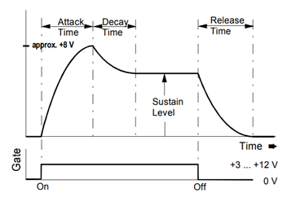
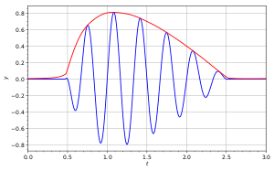
Modular Synthesis as Building Blocks
Voltage-controlled oscillator (VCO)
Sinusoid, triangle, sawtooth, square waveform outputs
Voltage-controlled amplifier (VCA)
Signal multiplier
Used for AM
Voltage-controlled filter (VCF)
Controllable cut-off
Many filter types
ADSR envelope
Attack, decay and release times
On/off-triggers

Slide 6


Overall System
Volume
Osc L
Stereo Blend
L
IIR
$$Σ$$
X
Detuned from Osc C
Osc C
Waveshaping
Filtering
Osc R
R
IIR
$$Σ$$
X
Vibrato FM (Sinusoidal)
ADSR volume and MIDI velocity
ADSR cut-off modulation
Fixed number of notes
Generator Manager
Assigns generators to notes
Triggers generators
Configures subcomponents

Slide 7
LUTs and Wavetables

Slide 8
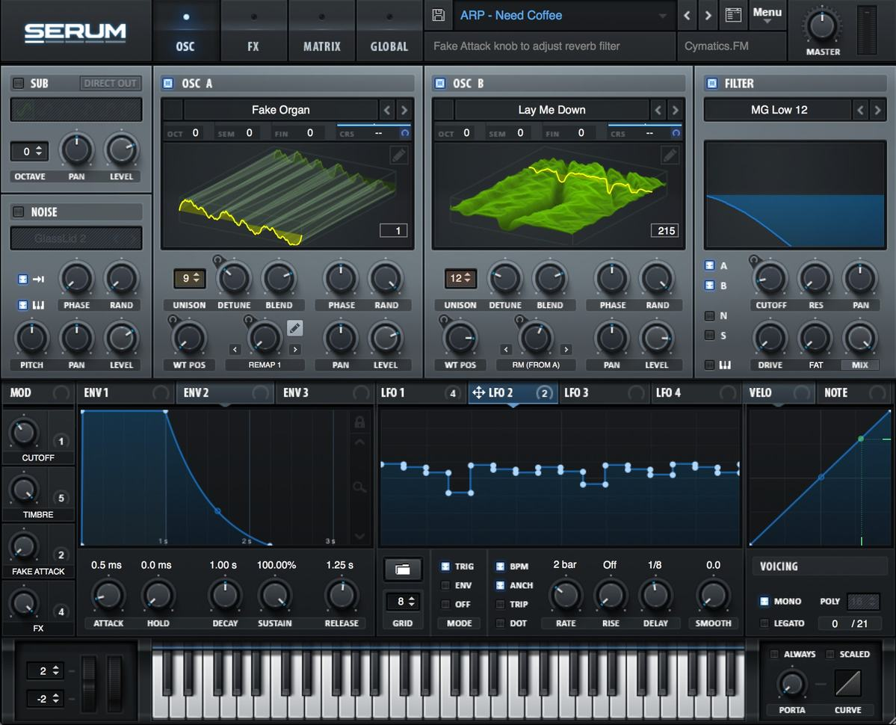
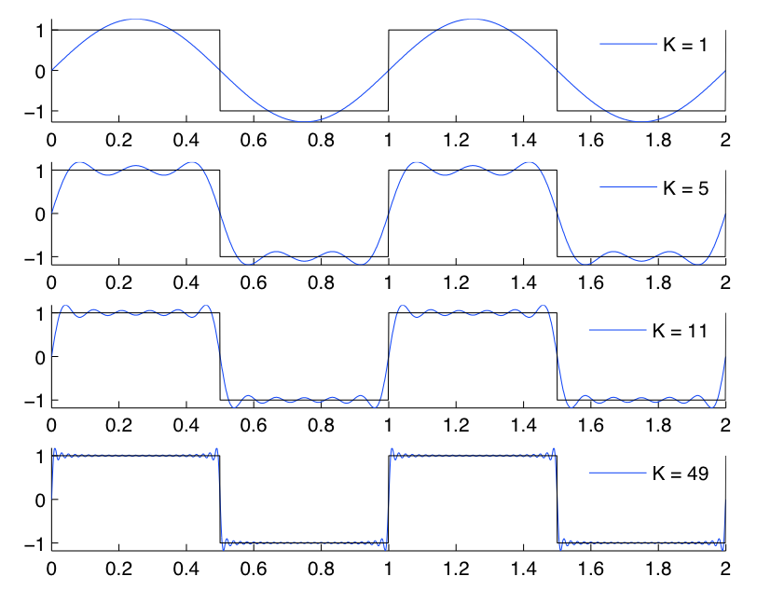
LUTs and Wavetables
Select correct number of harmonics to avoid aliasing
LUT treated as a circular buffer for periodicity
3 Dimensional Array
N samples per waveform
M harmonic copies per waveform
4 basic waveforms
Serum
A VST plugin (software synthesiser)
A popular wavetable synthesiser that allows inter-wavetable interpolation and arbitrary parameter modulation.
LUT index pointer sweep

Slide 9
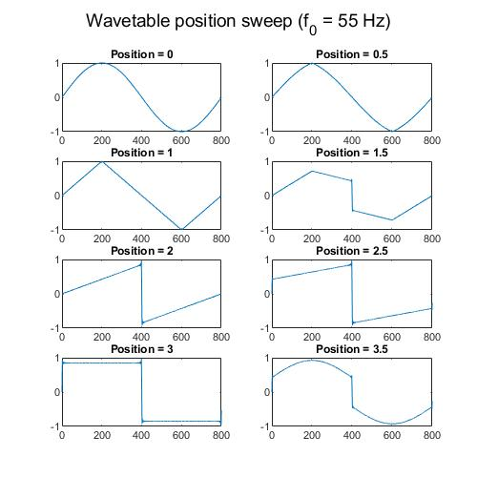
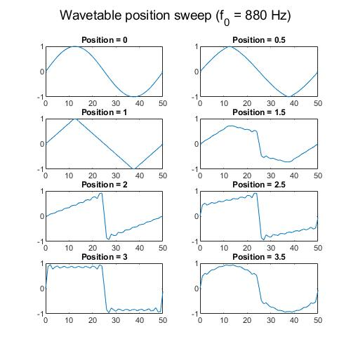
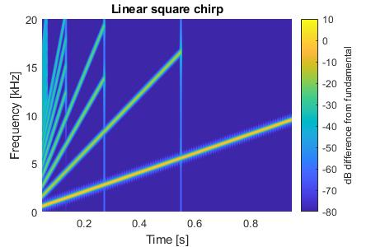
LUTs and Wavetables
Square-wave chirp
No aliasing occurs.
Note: harmonic reduction occurs when an even harmonics will alias, the square wave only contains odd harmonics. Thus, harmonics do not sweep all the way to the Nyquist limit.
Position sweep at varying frequencies
Inter-wavetable interpolation, and harmonic indexing can be clearly observed.

Slide 10
ADSR Envelope

Slide 11
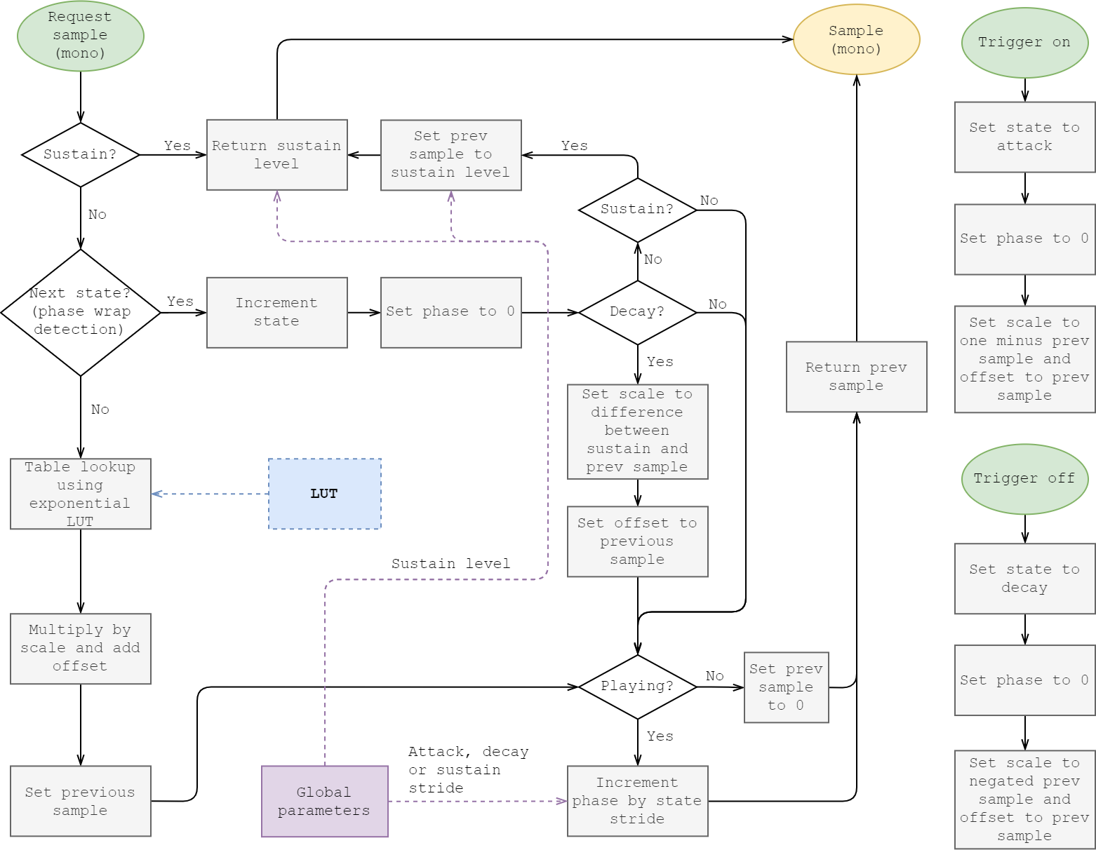
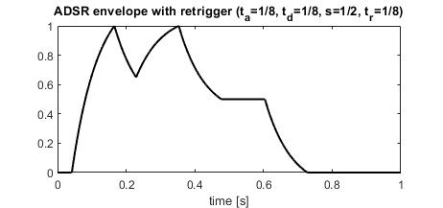
ADSR Envelope
ADSR envelope test
Correct attack, decay and release times are observed. Sustain level is correct. Successful retriggering occurs.
State machine implementation
Uses an exponential LUT for samples. Has retrigger capabilities (can enter the attack state arbitrarily).

Slide 12
Filters

Slide 13
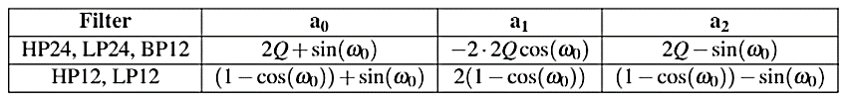
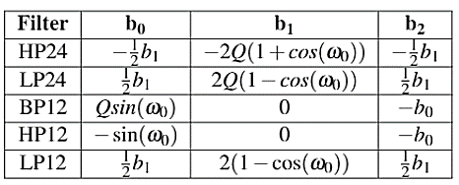
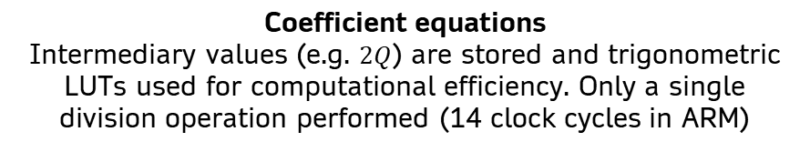
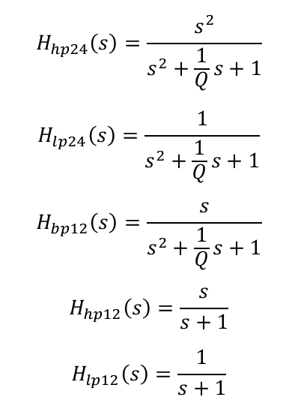
Filters
Discrete filter transfer function
Filter prototype transfer functions
24 and 12 dB/octave low, high and bandpass filters
$$H\left(z\right)=\frac{Y\left(z\right)}{X\left(z\right)}=\frac{b_{0}+b_{1}z^{−1}+b_{2}z^{−2}}{a_{0}+a_{1}z^{−1}+a_{2}z^{−2}}=\frac{N_{0}+N_{1}z^{−1}+N_{2}z^{−2}}{1−D_{1}z^{−1}−D_{2}z^{−2}}$$
$$H_{hp24}\left(s\right)=\frac{s^{2}}{s^{2}+\frac{1}{Q}s+1}$$
$$H_{lp24}\left(s\right)=\frac{1}{s^{2}+\frac{1}{Q}s+1}$$
$$H_{bp12}\left(s\right)=\frac{s}{s^{2}+\frac{1}{Q}s+1}$$
$$H_{hp12}\left(s\right)=\frac{s}{s+1}$$
$$H_{lp12}\left(s\right)=\frac{1}{s+1}$$
Discrete-time difference equation
$$y\left[n\right]=N_{0}x\left[n\right]+N_{1}x\left[n−1\right]+N_{2}x\left[n−2\right]+D_{1}y\left[n−1\right]+D_{2}y\left[n−2\right]$$
Bilinear transform
Coefficient equations
Intermediary values (e.g. $2Q$) are stored and trigonometric LUTs used for computational efficiency. Only a single division operation performed (14 clock cycles in ARM)

Slide 14
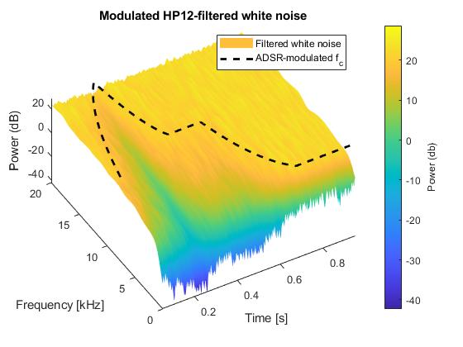
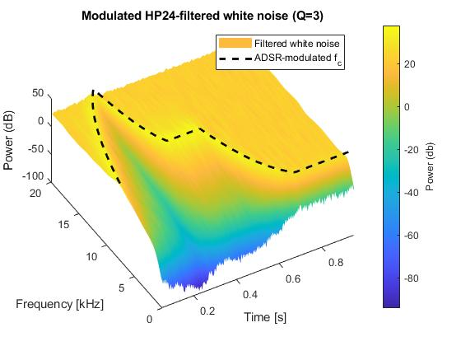
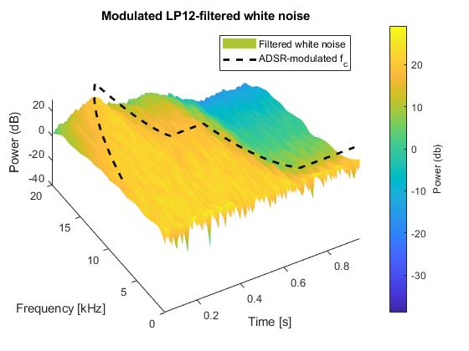
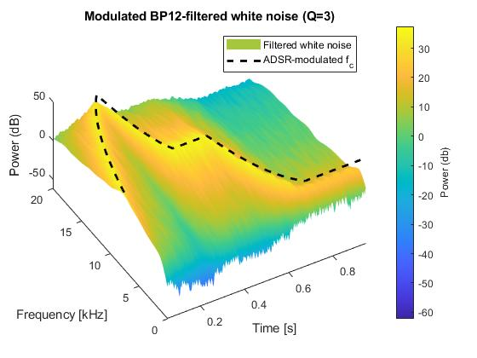
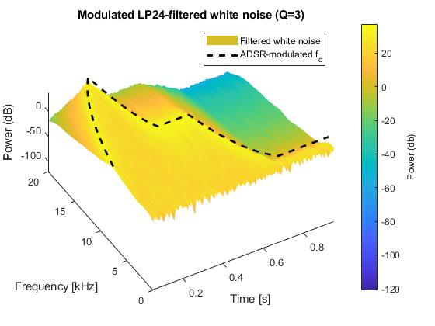
Filters
Filter tests
ADSR-modulated cut-off frequency.
Expected cut-off stored and plotted.
Q of 3 chosen where applicable.
Spectrogram data Gaussian blurred for clarity (similar to image processing)

Slide 15
Waveshaping

Slide 16
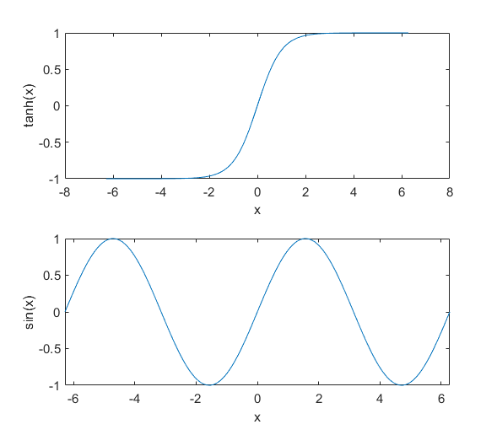
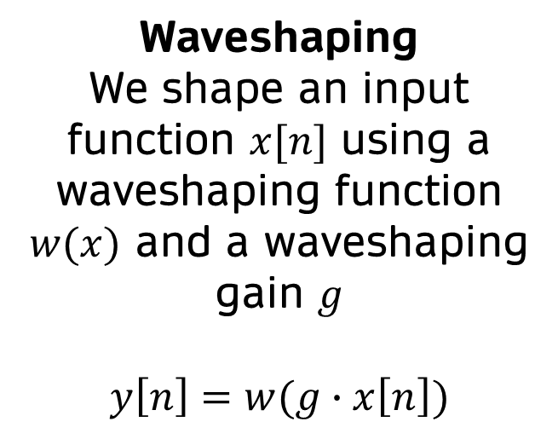
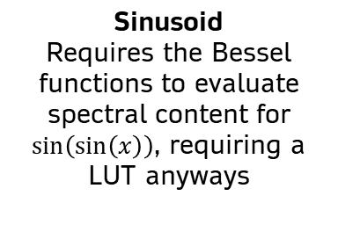
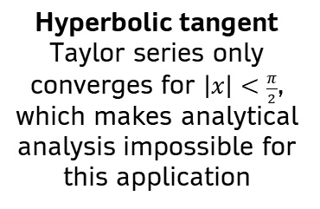
Waveshaping
Waveshaping functions
Spectra are difficult to determine analytically
Waveshaping
We shape an input function $x[n]$ using a waveshaping function $w(x)$ and a waveshaping gain $g$
$$y\left[n\right]=w(g∙x\left[n\right])$$
Hyperbolic tangent
Taylor series only converges for $\left|x\right|<\frac{π}{2}$,
which makes analytical analysis impossible for this application
Sinusoid
Requires the Bessel functions to evaluate spectral content for $\sin\left(\sin\left(x\right)\right)$, requiring a LUT anyways

Slide 17
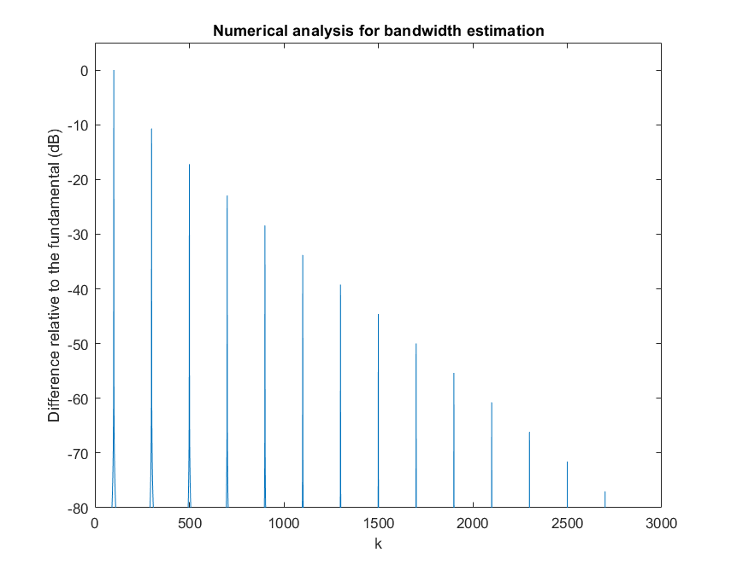
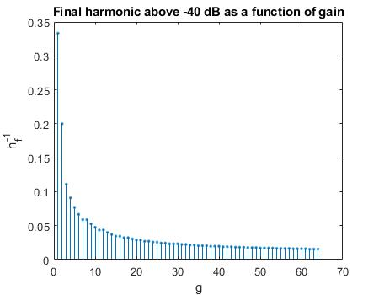
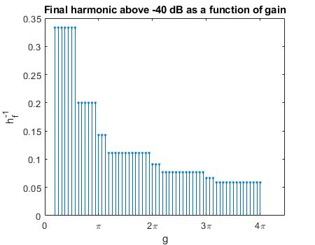
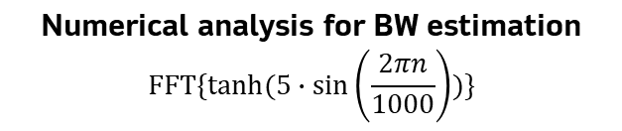
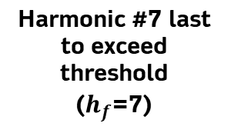
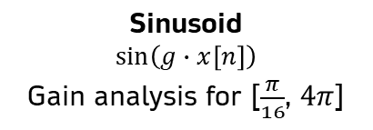
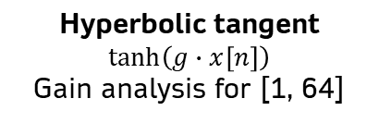
Waveshaping
Fundamental
(“Harmonic” #1)
Hyperbolic tangent
$$\tanh\left(g∙x\left[n\right]\right)$$
Gain analysis for [1, 64]
Harmonic #7 last to exceed threshold
($h_{f}$=7)
Sinusoid
$$\sin\left(g∙x\left[n\right]\right)$$
Gain analysis for [$\frac{π}{16}$, $4π$]
Estimated BW
Numerical analysis for BW estimation
$$FFT\{tanh(5∙sin\left(\frac{2πn}{1000}\right))\}$$

Slide 18
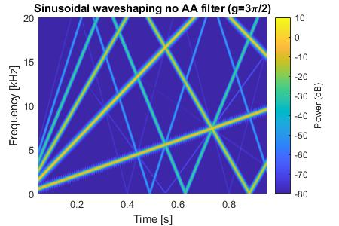
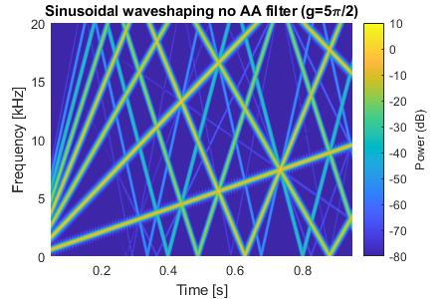
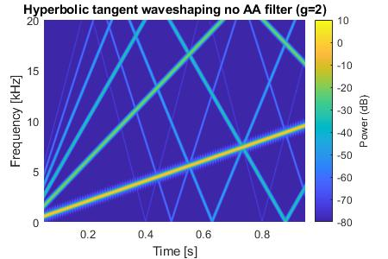
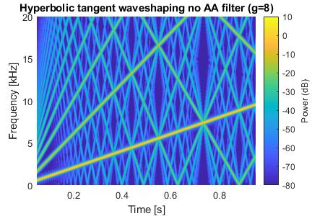
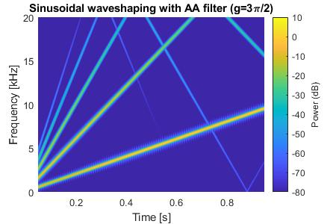
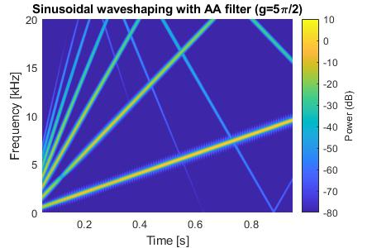
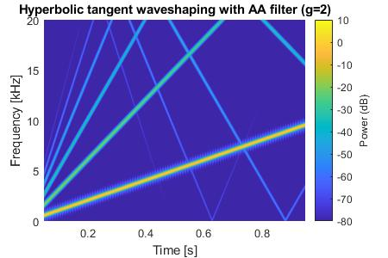
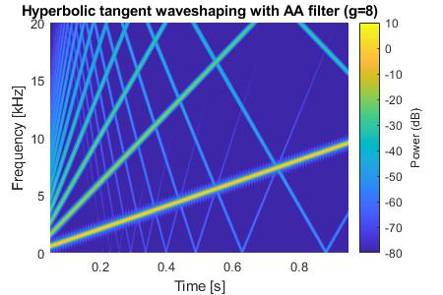
Waveshaping
Waveshaping without band-limiting filters
Waveshaping with band-limiting filters

Slide 19
Generator

Slide 20
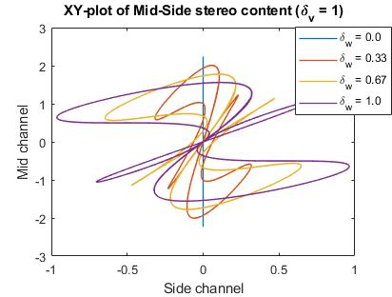
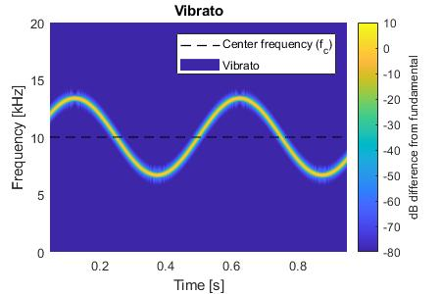
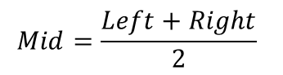


Generator
Lissajous plot
$$\left(x, y\right)= \left(Side, Mid\right)$$
Equivalent to an XY or parametric plot.
Mid content represents the mono’d signal. Side content represents the stereo content.
Vibrato FM
Sinusoidal FM with a frequency deviation specified in cents (1/100th of a semitone)
$$Mid=\frac{Left+Right}{2}$$
$$Side=\frac{Left −Right}{2}$$

Slide 21
Generator Manager

Slide 22


Generator Manager
Queue, stack and hashtable
O(N) management at worst
O(1) management for common operations
Array implementations
Overload management
Retriggers the oldest playing generator if at full capacity, using the queue
Freeing algorithm
Simple element shifting algorithm to free completed generators in O(N) time, once per audio buffer request

Slide 23


Generator Manager
Normal manager operation
Triggering 8 generators (max of 8) on and off, at a variety of frequencies, to show normal operation
Overload operation
Triggering 16 generators (max of 8) on (but not off), at a variety of frequencies, to show that the oldest generator is retriggered.

Slide 24
Full System Test

Slide 25



Full System Test
L/R channel spectrograms
Filter envelope can be clearly observed for the first note (500 Hz), and is limited to the audible range (max 20 kHz).
Left channel has a detuned oscillator above the fundamental, whereas the right has it below (full stereo width).
Detuned oscillators have a smaller amplitude than the fundamental (as configured).
The addition of the second note (10 kHz) is visible.
Slight aliasing occurs from hyperbolic tangent waveshaping.
Vibrato is clearly seen.
Even and odd harmonics can be seen (blended square and sawtooth).
L/R channel audio waveform
Volume envelopes can be observed, but is slightly obscured, due to a high Q filter sweep.
Slight differences in the channels can be seen in the waveforms.
The addition of the second note is visible.

Slide 26
Conclusion

Slide 27






Conclusion
MCU implementation
Implement system on MCU, and configure peripherals (such as SAI codec, DMA, etc.) to output stereo audio
Hold pedal
Supresses note-off triggers until pedal is released
Mod/pitch wheel
Mod wheel assigned to an arbitrary parameter, often vibrato intensity. Pitch wheel for pitch bend (FM)
MIDI control
Use MIDI protocol parameter change messages to control arbitrary parameters
The designed system
Can be used as the software basis for a more complex hardware-software system.
Arbitrary signal chain
Use a variety of control signals to allow the user for an arbitrary signal and parameter modulation

Slide 28
End of Presentation
Thank you for listening

